Slide 1
Week 2 (May 17 - May 21)
Previous work:
Data preprocessing pipeline
Trained on Vaccine/Travel data separately
Models:
Linear SVM (full data):
Vaccine: accuracy: 0.80, f1 score:0.68
Travel: accuracy:0.68, f1 score:0.63
BERT (10 days data): accuracy: 0.77, f1 score:0.76
CNN: fine tuning
Will do this week:
Create new linguistic features: NER
Explore new tags by unsupervised learning: LDA, k-means and explore new methods by reading papers.
What we need this week:
More verified data (Got)
Only recent 10 days data on vaccine
More domains such as travel
Hierarchy on other domains

Slide 2
Previous work:
Week 3 (May 24 - May 28)
Tuning models on full data set:
Linear SVM -- faster:
Vaccine: accuracy: 0.80, f1 score:0.68
Travel: accuracy:0.68, f1 score:0.63
Benefits: accuracy:0.71, f1 score:0.53
Tax: accuracy:0.73, f1 score:0.47
BERT -- more accurate:
Vaccine: accuracy: 0.86, f1 score:0.86
Travel: accuracy:0.72, f1 score:0.72
Benefits: accuracy:0.75, f1 score:0.74
Tax: accuracy:0.76, f1 score:0.75
Linguistic Features:
Name-entity Recognition (NER)
Sentiment Analysis
Dependency Structure
Semantic Roles
New tagging methods

Slide 3
Linguistic feature - Name-entity Recognition (NER)
Week 3 (May 24 - May 28)
Comment:
“Critical missing info:
Fed Govt needs to make it mandatory that Ontario provide detailedinfo
1) Cumulative percent of adult population who have received at least one dose of a COVID-19 vaccine
2) Distribution by PH Unit geographic catchment
3) Naming of # distributed to each health care institution”
NER:
[('Fed Govt', 'ORGANIZATION'), ('Ontario', 'LOCATION'), ('COVID-19', 'MISC'), ('PH Unit', 'ORGANIZATION')]
Noun Phrase chunks:
['info', 'Fed Govt', 'it mandatory', 'Ontario', 'Cumulative percent', 'adult population', 'dose', 'a COVID-19 vaccine', 'Distribution', 'PH Unit geographic catchment', 'Naming', 'each health care institution']

Slide 4
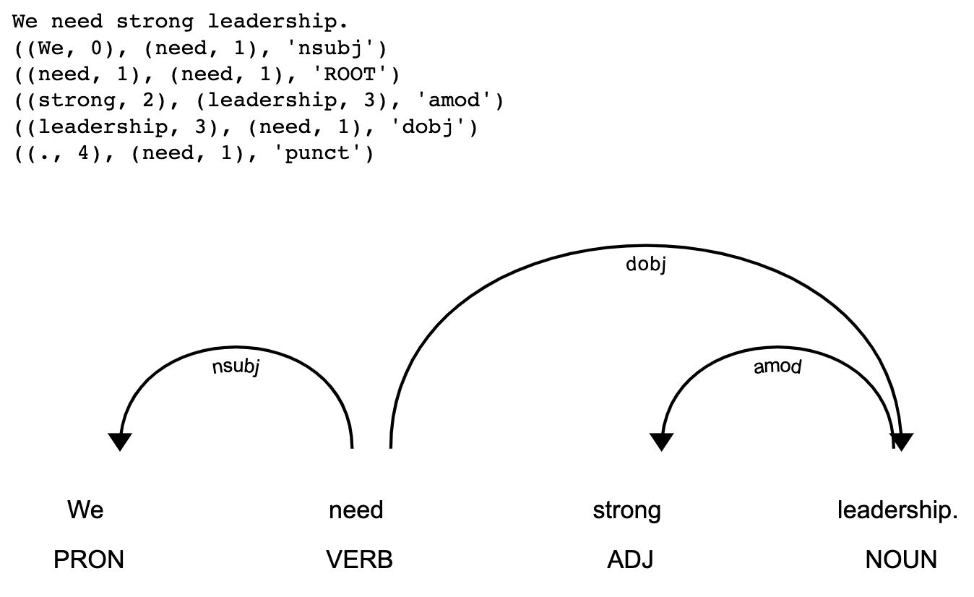
Linguistic feature - Dependency Structure
Week 3 (May 24 - May 28)

Slide 5
Linguistic feature - Sentiment
Week 3 (May 24 - May 28)
Critical missing info: Fed Govt needs to make it mandatory that Ontario provide detailedinfo 1) Cumulative percent of adult population who have received at least one dose of a COVID-19 vaccine 2) Distribution by PH Unit geographic catchment 3) Naming of # distributed to each health care institution
Sentiment: (1.3, [('missing', -1.2), ('mandatory', 0.3), ('care', 2.2)])
How reliable the shipment is ?? Spending on vaccine is not the solution. Why Canada can not make vaccine ?? Aren't we a develop country ??? No technology at all !! Aren't this TRUDO GOVT. realize that Canada is to vulnerable when is come to safety ?? We need strong leadership. This guy NO GOOD
Sentiment: (-6.8, [('??', -2), ('??', -2), ('???', -2), ('!!', -2), ('vulnerable', -0.9), ('safety', 1.8), ('??', -2), ('strong', 2.3)])

Slide 6

Linguistic feature - Semantic Role Labelling (SRL)
Week 3 (May 24 - May 28)
INPUT: a comment
Critical missing info: Fed Govt needs to make it mandatory that Ontario provide detailedinfo 1) Cumulative percent of adult population who have received at least one dose of a COVID-19 vaccine 2) Distribution by PH Unit geographic catchment 3) Naming of # distributed to each health care institution
OUTPUT: a table that answers “who did what to whom in which way”
Agent | Action | Item | Extra
N/A | missing | info | : Fed Govt needs to make it mandatory that Ontario provide detailedinfo 1) Cumulative percent of adult population who have received at least one dose of a COVID-19 vaccine 2) Distribution by PH Unit geographic catchment 3) Naming of # distributed to each health care institution
Fed Govt | needs | make it mandatory that Ontario provide detailedinfo 1) Cumulative percent of adult population who have received at least one dose of a COVID-19 vaccine 2) Distribution by PH Unit geographic catchment 3) Naming of # distributed to each health care institution. | N/A

Slide 7
Tags Generation - Topic Model
Week 3 (May 24 - May 28)
Vaccine Tags:
Generated Topics:
Tags | Count
Getting vaccinated - When / Where / What | 7605
Getting vaccinated - Registration / notifications | 7282
Vaccine safety (health issues / ingredients / side effects / research) | 4732
Data and tracking vaccines | 3558
Vaccine effectiveness / delayed dosage | 3185
Vaccine strategy: Authorization / Eligibility / Priorities | 1475
Vaccines - Other | 1264
Life after vaccination | 191
Topic | Count | Explain
-1_the_to_vaccine_is | 17812 | Getting vaccinated - When / Where / What
53_vaccin_de_le_je | 2605 | French comments
61_old_when_years_for | 1869 | Vaccine for aged people
130_no_johnson_not_vaccine | 1163 | No information about johnson vaccine
102_vaccine_covid_covid vaccine_for | 1091 | Register for vaccine
87_vaccination_vaccinated_to_get vaccinated | 896 | Getting vaccinated - When / Where / What
107_side_effects_side effects_vaccine | 888 | Vaccine safety (health issues / ingredients / side effects / research)
30_second_dose_2nd_second dose | 843 | Second dose
55_19_covid 19_covid19_covid | 720 | Covid-19
60_in_ontario_when_vaccine | 704 | Vaccine in Ontario
97_book_appointment_to book_an | 701 | Book appointment

Slide 8
Tags Generation - Topic Model
Week 3 (May 24 - May 28)
Travel Tags:
Generated Topics:
Tags | Count
Restrictions or Requirements | 2678
Hotels | 2613
Can I enter Canada | 2146
Quarantine | 1618
Testing | 1274
Provincial restrictions | 927
Other (Contact / Travel outside / ArriveCan / Mad people ) | 765
Design / content | 693
Topic | Count | Explain
-1_to_the_in_and | 6213 | Can I enter Canada
7_not_no_the_is | 1263 | No information
0_de_je_pour_la | 863 | French comments
24_vaccinated_have_if_covid | 794 | Do I need to quarantine if vaccinated
3_hotel_the_quarantine_days | 756 | Quarantine days in hotel
35_vaccinated_canada_if_have | 598 | Enter Canada if vaccinated
4_my_to_and_in | 564 | Relatives travel
46_my_canadian_to_and | 488 | Family visit
30_in_to_hotel_calgary | 426 | Quarantine hotel in different destination
41_canada_to_travel_province | 407 | Provincial restrictions
31_to_flight_from_the | 353 | Flight and airport

Slide 9
Week 3 (May 24 - May 28)
Will do this week:
Add linguistic features to machine learning models.
Keep exploring unsupervised learning models to generate new tags.
What we need this week:
Do we need to make prediction to domains from comments?
Will we name new tags or will you provide a tag pool?

